Slide 1
Lincoln Absence management Services- Supervisors
ARUP Labs
February 28, 2019
Notes:
Welcome, and thank you for joining us to discuss Lincoln Absence Management Services, with integrated absence administration capabilities.

Slide 2
What is FMLA?
The Federal Family and Medical Leave Act (FMLA) was passed in 1993 in order to provide unpaid leave for employees; the act has been expanded several times
FMLA provides up to 12 weeks of unpaid, job protected leave during any 12-month period
FMLA and other state mandated job protected leaves may or may not run concurrently with paid leave such as disability, Workers’ Compensation, or PTO
While on FMLA leave, an employee is protected from being terminated for being absent from work due to a FMLA qualified leave, health benefits must be continued, and upon return the employee must be restored to his/her original or equivalent position.
In some cases (to care for an injured military service member) the leave may extend up to 26 weeks.

Slide 3
FMLA Qualified leave reasons
Placement of a child for adoption or foster care within the year following placement
Care for an injured service member
Qualifying exigency for employee’s parent, child, or spouse called to active duty
An employee’s own serious health condition that prevents him/her from working
To care for a family member with a serious health condition (spouse, child, parent)
For the birth or care of a newborn child within the first year of the child’s birth

Slide 4
FMLA Eligibility VS Approval
There are two steps in the FMLA determination process
Is an employee eligible for FMLA
If eligible, is an employee approved for FMLA

Slide 5
FMLA Eligibility requirements
To be eligible for FMLA leave an employee must meet the following requirements.
Worked for their employer for a total of 12 months (need not be consecutive). This may include any time spent working as a temporary employee.
Worked for their employer for 1,250 hours in the 12 months preceding the leave of absence request. This must include any time spent working as a temporary employee.
Works at a location with at least 50 employees within 75 miles.

Slide 6
FMLA Approval requirements
To be approved for FMLA leave an employee must meet the following requirements.
Qualified for a reason covered under the FMLA laws
Provide all documentation to LFG to consider FMLA leave
Provide provider certification to LFG

Slide 7
Absence schedules
Continuous
Employee is out for a ‘continuous’ period of time of 3+ consecutive days.
For example, an employee may be out from May 1st through July 12th.
Intermittent
Employee takes leave on an ‘intermittent’ basis.
For example, an employee that has an illness causing incapacitation may require an absence on June 4th but not again until September 2nd.
Reduced Schedule
Employee works a ‘reduced’ schedule which is predictable.
For example, an employee may work part-time, 4 days per week, or 4 hours per day requiring a predictable absence pattern.

Slide 8
ARUP Laboratories, Inc. absence management specifics
In addition to FMLA, state leaves and Short Term Disability, Lincoln Financial Group manages the following absence types for ARUP Laboratories, Inc.
USERRA (Military Leave)
MLOA (Medical Leave of Absence)
PLOA (Personal Leave of Absence)

Slide 9
Leave of absence vs. long term sick
Leave of Absence
Long Term Sick
Serious health conditions:
Not a serious health condition
Inpatient Care
Incapacity for more than three days without continuing treatment by a health care provider
Chronic serious health conditions
Permanent or long-term incapacity, and certain conditions requiring multiple treatments.
Colds and the flu
Earaches
Upset stomachs and minor ulcers
Headaches (other than migraines)
Routine dental or orthodontic problems or periodontal disease
Cosmetic Treatments, unless complications arise or inpatient care is required

Slide 10
Absence management process
Employee requests a leave of absence..
Consideration and decision of whether the employee is eligible for leave is made. Absence acknowledgement is mailed and emailed to the employee. An email notification is sent to ARUP Labs to provide notice of absence request.
If a completed certification has not been returned, a reminder will be sent to the employee.
A determination will be rendered based on the certification or the incomplete process will be initiated.
Completed certification must be returned to Lincoln Financial Group.
Day 1-5
Day 15
Day 1
Day 10
Up to 5 days following receipt of certification
Notes:
If a situation of successor in interest or joint employment is applicable, eligibility will be verified with employer and the eligibility notification may not be sent to the employee until at the latest, day 5.
The absence acknowledgement packet includes a request for more information (certification) as to whether the absence reason is a qualified reason.

Slide 11
Leave of Absence management
Absence event
Lincoln Financial Group Absence Management Contact Information:
Phone: 800-423-2765
Web: Available through single sign-on by going to www.LincolnFinancial.com
Intake absence
Determine eligibility for all absence types
Eligibility letter sent to employee with applicable certification forms
Single certification form required for Short Term Disability and Family Medical Leave
Single Claims Examiner manages entire claim
Each absence type is reviewed independently according to its’ own eligibility rules and certification requirements
Employer and employee are informed of all decisions. Where possible, an integrated letter for all absence types will be used.
Prior to the end of the approved period of time, the Claims Examiner will contact the employee to confirm intent to RTW.
The employer is informed of all extension requests or return to work detail.
Technology & Reporting
Communication
Mobile application available to employees and managers 24/7
HR portal for detailed reporting and claim inquiry
On-going communication to employee and employer to ensure clear understanding of status and outcomes

Slide 12
Incomplete process
If a certification received is incomplete, an incomplete notice will be sent to the employee.
The employee will have 7 days (plus a 3 day silent grace period) to return the missing or incomplete information.
If the missing or incomplete information is not returned and we have the employee’s written permission, a call to the provider will be made on day 11 and day 12.
If the information is still not returned, a determination will be made based on the information available.
At any point during this process, if the information is returned and the certification is complete the leave of absence will be reviewed and a timely determination will be made.
For absences running concurrent with a Short Term Disability claim, with a signed authorization, medical records may be requested to obtain the incomplete information. Decisions for both absence types will be made independently and in accordance with those absence type policies and guidelines

Slide 13
Intermittent Absence Management
Intermittent leaves must be reported and certified as per any other leave. Lincoln will require a certified intermittent frequency and duration.
Intermittent occurrences must be reported to Lincoln Financial Group within 2 business days of the absence.
Lincoln Financial Group will inform employees they must also follow ARUP Laboratories, Inc. documented time-off reporting procedures.
When an intermittent occurrence is reported, Lincoln Financial Group will inform designated employer contacts (Humanresourcesbenefits151@aruplab.com) via e-mail, as defined during implementation.
The smallest increment of intermittent time that may be reported is 1 minute.

Slide 14
Intermittent absence management (continued)
Lincoln Financial Group monitors intermittent occurrences. If an employee exceeds the approved frequency or duration more than one time for any open leave of absence, he/she will be required to recertify the leave.
Lincoln Financial Group also monitors for patterns of absence. For example, if an employee consistently reports incapacity on Monday mornings, he/she may be requested to recertify the intermittent leave of absence.
If an employee needs additional leave time following the initial certification, he/she will need to contact Lincoln Financial Group to initiate the recertification process. We will not automatically initiate a new Intermittent leave for the employee once the initial leave certification has expired.

Slide 15
Leave of Absence End
Job Protected Leave Exhaustion
When an employee on an approved job protected absence type (FMLA, State Leave), has used 75% of his/her available leave time, a notification will be sent to the employee and employer. The employee and employer will also receive a notification when the job protected leave is exhausted. (Note: If more than one absence type is job protected (eg. FMLA and state leave), the Exhaustion warning and notice will be based on the longest approved job protected leave.
Return to Work (RTW)
About a week before an employee’s continuous leave is scheduled to end, the Lincoln Claims Examiner will contact the employee to confirm his or her intent to RTW.
The day prior to the expected return to work date, the claims examiner will reach out via email to the supervisor to remind them that the employee is scheduled to return.

Slide 16
Supervisors contact with LFG
Throughout the course of a claim, the supervisors will receive the following correspondence via e-mail:
Copy of the Eligibility Letter
Absence Determination
Intermittent Time Usage Notice
Absence Re-certification
Exhaustion of Job Protection
Return to Work Notification
Leave of Absence Cancelation
**HR is copied on all notices except the intermittent time usage notice

Slide 17
Employee Responsibilities
Contact Lincoln Financial Group when the need for leave arises.
Complete and submit the required documentation within specified timeframes.
Report new absence requests and intermittent occurrences within the appropriate timeframes. For intermittent FMLA, time must be reported within two business days of the leave to be considered.
Follow your company’s documented reporting procedures for time-off requests. This includes notifying your supervisor prior to (or as soon as reasonably possible) that you will not be at work.
Periodically inform your manager of your status and intent to return to work.
Inform Lincoln if any circumstances of the leave change.

Slide 18
Employee Responsibilities
Communicate treating physician information to LFG during intake process.
It is important for the provider to know the dates of acute illnesses as well as chronic conditions to understand leaves.
If utilizing the ARUP health clinic, keep in contact with them during acute illnesses to ensure they understand the conditions.
Clinic Hours are 6a-5p M-F
8a-4p Sat

Slide 19
Supervisor Responsibilities
Refer people to LFG when they request a leave
Ensure to notify employee to utilize treating physician instead of referring them to the health clinic for medical certification
Enforce call in procedures and timely notification- especially intermittent time. This includes notifying LFG as well as the supervisor
Assist when employees are unable to file a claim- oftentimes this may include partnering with HR
Enforcing return to work procedures. When an employee hasn’t returned on the day expected, work with HR to determine next steps.

Slide 20
Supervisor interaction with employees on fmla
The law protects employees from interference and retaliation for exercising or attempting to exercise their FMLA rights.
Noting that employees are “causing an issue” by taking leave
Making employees feel guilty for taking an approved leave
Do not direct employees to take FMLA, this is a provider/employee discussion
If you, as a supervisor, has concerns, please contact HR so that they can understand and address with the employee, if necessary.
Understand that employees taking leave can be in a very challenging place in their life.

Slide 21
Reporting a leave of absence
A new leave of absence is most often reported by the employee. If you are unable to report the leave himself/herself, the employee’s family member or employer may do so on the employee’s behalf.
All applicable absence types including FMLA, state leave, Short Term Disability (STD) and/or company leaves will be initiated with a single phone call
To report a new leave of absence:
-Call 1-888-244-7535
-Option 1 (if you are an insured)
-Enter your Social Security Number
-After confirming social security number, select option one which will connect you to a representative that will assist with both the absence and short term disability claim.
Notes:
Please note: Lincoln will deny or delay FMLA absences reported later than seven calendar days (AIS adjust number of days as necessary) following the start of the leave without documentation of an extenuating circumstance that prevented the employee from reporting your leave of absence timely.

Slide 22
Lincoln financial group contact information
Give us a call!
Available 8:00 AM – 6:00 PM MT, Monday thru Thursday
Available 8:00 AM – 6:00 MT Central, Friday
Visit us on the Web!
Report an absence, ask a question, etc.
(800) 244-7535
Available through single sign-on by going to www.LincolnFinancial.com
Report an absence, check the status of a leave of absence request, run a report, etc.
Available 24/7/365

Slide 23
Mobile application
Available 24/7 for employee and employer access to a number of self-service functions, including:
Entering a new claim
Checking the status of an existing claim
Adding intermittent time
Etc.
Smartphone is not required—content is available via a desktop as well
Notes:
Our mobile-enabled self-service portal for employees and managers is designed with ease-of-use in mind, ensuring that entering or finding information about an absence is hassle-free. Red indicates the absence time is denied, green is approved, while yellow is pending.

Slide 24
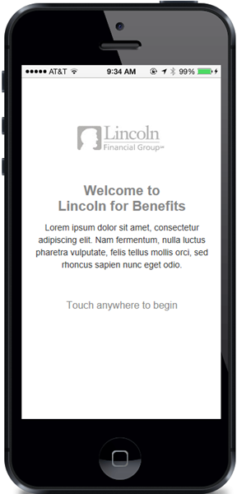
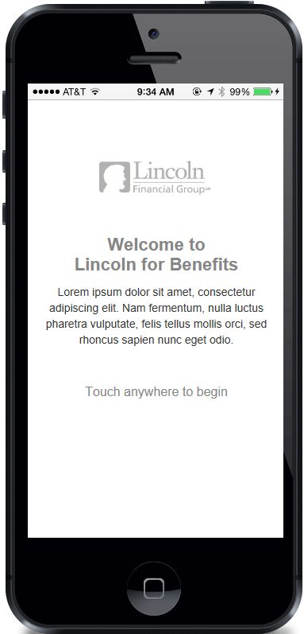
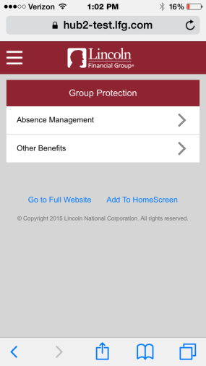
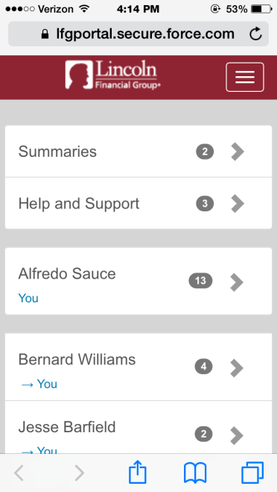
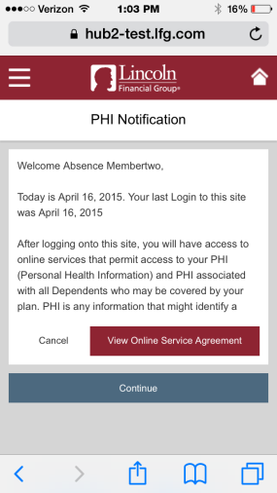
Mobile application
Access to the mobile portal is available through single-sign on to www.LincolnFinancial.com. Users will be prompted to log in or register for consistency of experience and a single set of credentials.

